Slide 1





PRESENTATION 2026
From Data Chaos To Clarity: Healthcare Analytics For Operational Excellence.
Student Name
Srishti Sharma
Student Email
Srishtisharma58435@gmail.com
Mentor Name
Guide Name
Umamaheshwari Ma’am
P Raja Sir

Slide 2

Outline
Abstract of the Project
Problem Statement
Proposed Solution
System Architecture
Live Demo of the Project
Embedded Video of Project
Conclusion
Future Scope

Slide 3
Abstract
This project is about cleaning hospital patient data and creating a simple dashboard to understand health-related information better. Hospital data often has errors like missing values, duplicate records, and inconsistent formats. In this project, these issues are fixed to make the data accurate and reliable.
Objectives: The main goal is to improve data quality and get useful insights from it. This includes understanding patient details, tracking diseases, analyzing admission trends, and checking treatment outcomes. It also helps hospitals manage resources and improve patient care.
Tools & Technologies: Tools used in this project include Excel for basic analysis, making Pivot Table to make an attractive Dashboard in excel.
Overall, this project shows how clean data and easy-to-understand dashboards can help hospitals make better decisions and improve healthcare services.

Slide 4

Problem Statement
Lack of Patient Journey Visibility-Data does not show the complete flow (arrival → wait time → treatment → admission), making it hard to track efficiency.
Hidden Relationships Between Variables-Important insights (like impact of wait time on satisfaction) are not directly visible and require calculated fields and deep analysis.
No Direct KPI Structure-The dataset doesn’t define key performance indicators (KPIs), so metrics like average wait time, admission rate, and patient satisfaction had to be created manually.
Difficulty in Real-Time Insight Simulation-Raw data is static, but the dashboard needed to simulate dynamic decision-making using slicers and filters.
Multi-Dimensional Data Complexity-Combining multiple dimensions (time, department, patient type, satisfaction) into a single dashboard without clutter was challenging.

Slide 5

Proposed Solution
To address the lack of integrated insights, the raw hospital emergency dataset is transformed into a structured analytical model by creating calculated KPIs such as average wait time, patient satisfaction score, and admission rate.
Data is reorganized to reflect the complete patient journey, enabling better tracking of service flow. An interactive dashboard is developed using pivot tables, slicers, and dynamic charts to connect multiple variables like time, department, and patient type. This approach helps uncover hidden relationships, identify performance bottlenecks, and simulate real-time decision-making for improving emergency room efficiency.

Slide 6
System Architecture
Data Input / Source
Processing / Analysis
Data Cleaning: Removed duplicates, corrected data types, standardize disease department category & formats, sort date errors & fix address errors.
Analysis/ processing: excel formulas, and analyzing of data through dashboard.
Generated the raw dataset of hospital emergency room , the file with 532 rows and 13 columns of patient records.

Slide 7
AI / Tool Integration
Output / Dashboard
Excel: Removing duplicates, fixing date formats, correcting department categories and conditional formatting.The following tools and techniques were used :
Data Cleaning: Raw hospital emergency room data was cleaned using functions like sorting, filtering, and removing duplicates. Inconsistent entries were corrected to improve data accuracy.
Pivot Tables: Pivot tables were created to summarize large datasets quickly.
Data Visualization (Dashboard): An interactive dashboard was developed using charts, slicers, and graphs.
The final output is an interactive Excel dashboard created using cleaned hospital emergency room data. With the help of pivot tables and charts, it shows key insights like total patients, waiting time, admission trends, and department-wise analysis. The dashboard uses filters and slicers for easy data viewing and helps in better decision-making, identifying peak hours, and improving patient care.

Slide 8
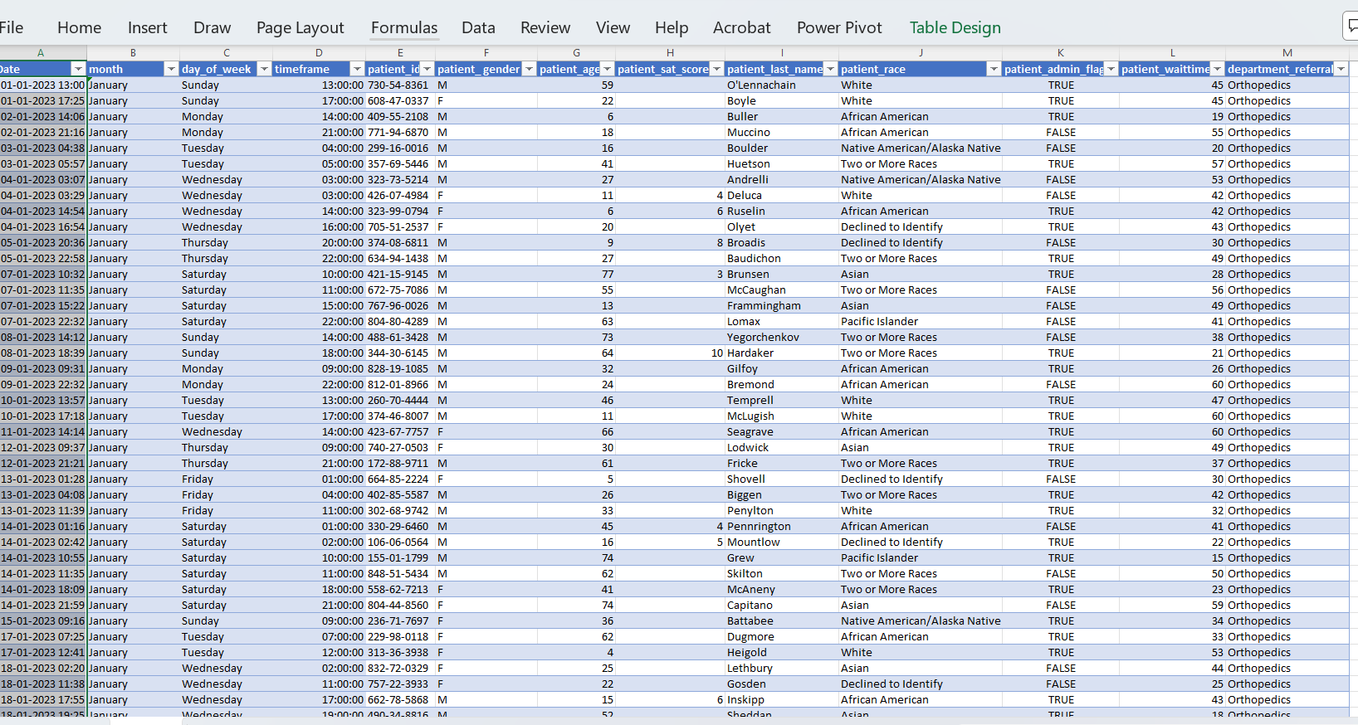
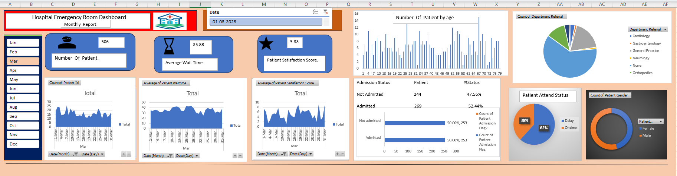
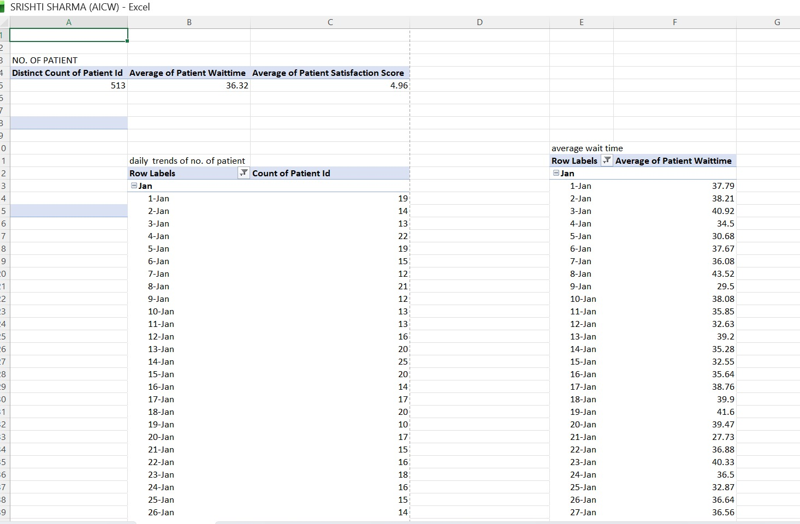
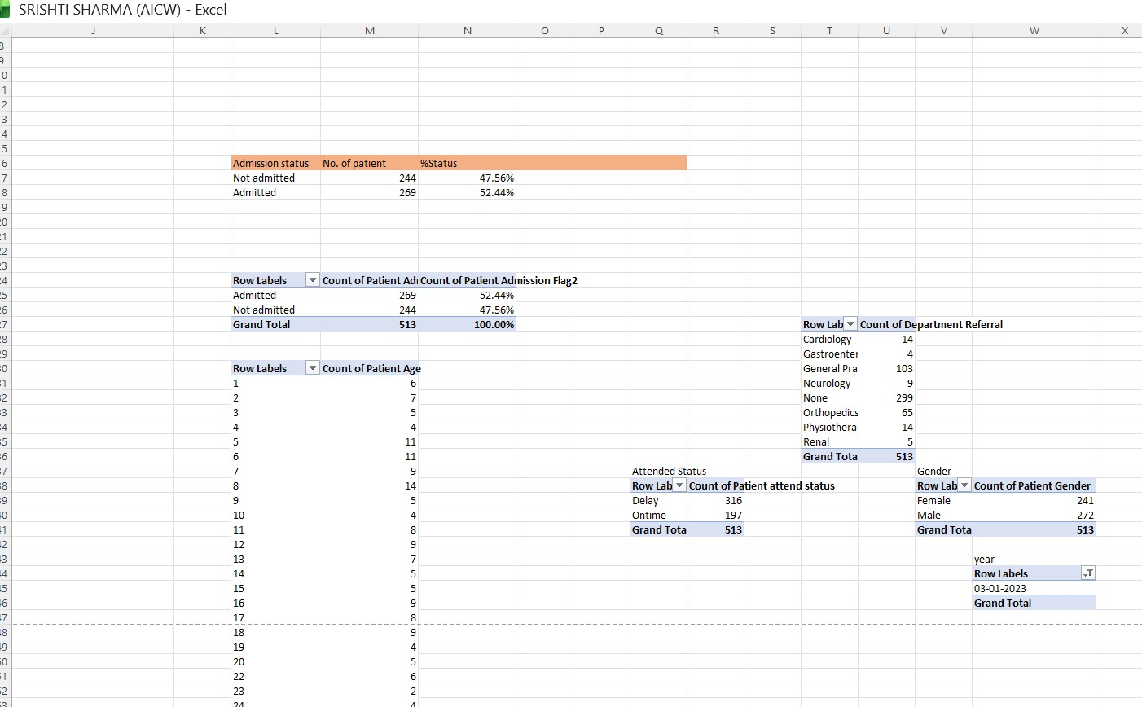
Live Demo of Project
Here's the list of some demo screenshots / features of the project:
Demo 1
Cleaned data into structured standardized format.
Prepared Dashboard in Excel by using pivot table.
Pivot Table use to Create a attractive dashboard in excel.

Slide 9
Video of Project Demo
[https://your-project-https://drive.google.com/file/d/1HVyWUJaS0mXUJqZAh0sIWjmRuTrwpMsW/view?usp=drive_linkdemo-link.com]
▶
[Insert your project demo video.
You can embed a video your live project.]

Slide 10

Conclusion
This project successfully transformed fragmented hospital emergency room data into a structured and interactive dashboard, enabling clear visibility of patient flow, wait times, and service efficiency. By developing custom KPIs and integrating multiple data dimensions, hidden patterns and performance gaps were identified effectively. The dashboard not only simplifies complex data analysis but also supports better and faster decision-making in emergency healthcare management, demonstrating the practical value of data analytics in improving operational efficiency.
CONCLUSION

Slide 11

Future Scope
Integration with real-time hospital data systems for live patient tracking.
Use of advanced tools like Power BI or AI for predictive analysis (e.g., patient inflow, waiting time).Automation of data cleaning processes to reduce manual effort and errors.
Inclusion of more KPIs such as patient satisfaction, treatment efficiency, and staff performance.
Mobile-friendly dashboards for quick access by hospital management.
Expansion to multi-department analysis beyond emergency rooms.
Improved data visualization techniques for better decision-making.
This project can be further enhanced by adopting modern analytics tools and real-time data integration for smarter healthcare management.

Slide 12
Thank You
AICW Fellowship | Student Project Presentation 2026
LinkedIn | Edunet Foundation

